Slide 1


GMR Institute of Technology
An Autonomous Institute Affiliated to JNTUK, Kakinada
MINI PROJECT
EXTERNAL REVIEW
Department of Information Technology

Slide 2
ANTI- ACCIDENT ALERT SYSTEM
GUIDE NAME: STUDENT NAMES:
Dr.P.Kanchanamala S. Chandra Sai
HOD of IT Dept T. Jyothirmayi
GMRIT Sonia Gupta
K. Pavan Kumar
P. Lakhan Naidu.

Slide 3
Abstract
In India the roads are narrow and the rate of vehicles are increasing day by day. Because of that a lot of traffic has been occurring and we come across many accidents every day. In those most are occurred due to drunk and drive or late night traveling or sleepy driving. So we would like to present a solution which we thought would be beneficial to all the people. This sensor sense the object moving towards it from a certain fixed distance. If the distance is less then the sensor gives a buzzer sound and turns to left side, if the distance is still lesser than the previous then the brakes are applied automatically so that the accidents can be avoided. If the distance is too less then an alert message is sent to the peer contacts. By this we can avoid a lot many accidenta which are occurring in our day to day life.

Slide 4
Components
Hardware Components
Arduino UNO Board
Ultrasonic Sensor
Buzzer
Bread Board
Jumper wires & 9v Battery
L293D Motor Driver
DC Motors
ESP8266 WIFI

Slide 5
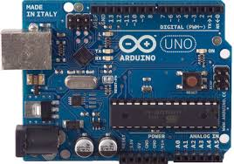
Arduino UNO
Arduino is a computer hardware and software company, project, and user community that designs and manufactures micro controller kits for building digital devices and interactive objects that can sense and control objects in the physical world. The project's products are distributed as open-source hardware and software, which are licensed under the GNU Lesser General Public License (LG-PL) permitting the manufacture of Arduino boards and software distribution by anyone. These are available commercially in preassembled form, or as kits.
It has 14 digital input/output pins (of which 6 can be used as PWM outputs), 6 analog inputs, a 16 MHz crystal oscillator, a USB connection, a power jack, an ICSP header, and a reset button.

Slide 6
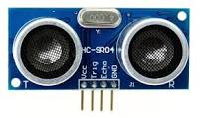
Ultrasonic sensor
The Sensor is a sonar type, it is used for calculating the distance/direction of an object from the time it takes for a sound wave to travel to the target and come back. This sensor is a speaker or microphone that emits or receives a ultrasound

Slide 7
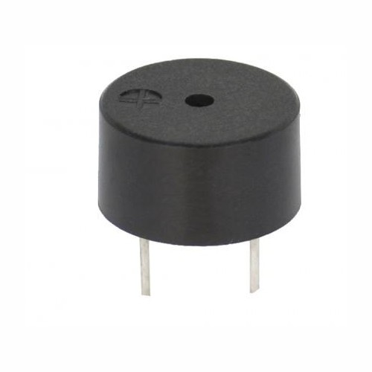
Buzzer
A buzzer or beeper is an audio signaling device which may be mechanical, electromechanical, or piezoelectric. Typical uses of buzzers and beepers include alarm devices, timers, and confirmation of user input such as a mouse click or keystroke.

Slide 8
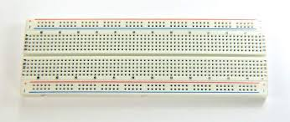
Breadboard
A Breadboard is a solder less device for temporary prototype with electronics and test circuit designs. Most electronic circuits can be interconnected by inserting their terminals into the holes and making connections through wires.
The Breadboard has strips of metal underneath the board and connect the holes on the top of the board.

Slide 9
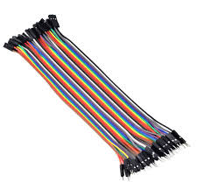
Jumper wires
A jumper wire is a conducting wire used to transfer electrical signals between two points in a circuit. The wires can either be used to modify circuits or to diagnose problems within a circuit.

Slide 10
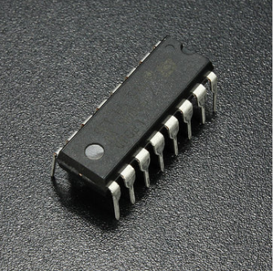
L293D Motor driver
L293D is a typical Motor driver or Motor Driver IC which allows DC motor to drive on either direction. L293D is a 16-pin IC which can control a set of two DC motors simultaneously in any direction. It means that you can control two DC motor with a single L293D IC.

Slide 11
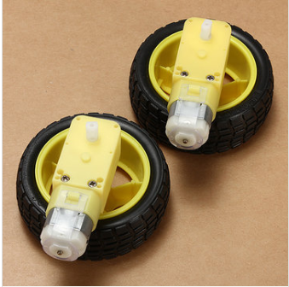
DC Motors
A DC motor is any of a class of rotary electrical machines that converts direct current electrical energy into mechanical energy. The most common types rely on the forces produced by magnetic fields.

Slide 12
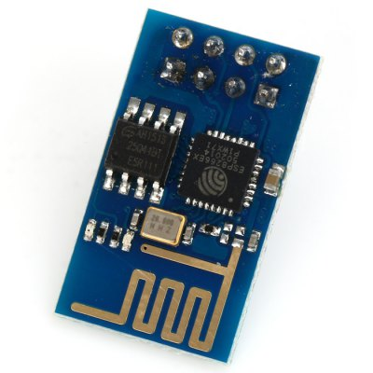
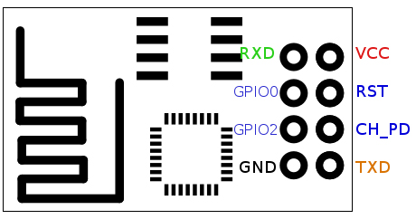
ESP8266 WIFI
Esp8266 is a wifi module which provides a easy way to connect any small microcontroller platform like arduino to internet wirelessly. It is low cost and can use AT commands to connect to wifi and open to TCP connections without running TCP/IP stack. It also includes 32bit microcontroller to which can be programmed to act as a standalone WIFI connected embedded platform.

Slide 13
METHODOLOGY
We have extended our project by implementing some more modules by increasing the safety level
Through buzzer and a emergency light, we alert the driver.
The brakes are applied automatically using automatic braking system due of the negligence of the driver.
In case the braking system fails due to some reasons an alert message is send to the family members.

Slide 14
Alert system
Alert system means giving alert sound when obstacle is nearer to the vehicle.
Obstacle is detected by ultrasonic sensor, and it will active the buzzer to give an buzz sound.

Slide 15
Supporting code
if (safetyDistance < 20){
digitalWrite(buzzer, HIGH);
}
else{
digitalWrite(buzzer, LOW);
}

Slide 16
Automatic braking system
We have Navigation system that turns left when an obstacle is avoidable just by changing the direction to the left side avoiding the accident or trouble.
Automatic braking is a technology for automobiles to sense and avoid collision with another vehicle, person or obstacle by braking without any driver input.
Automatic braking system can be implemented by using PWM concept with using L293D motor driver.

Slide 17
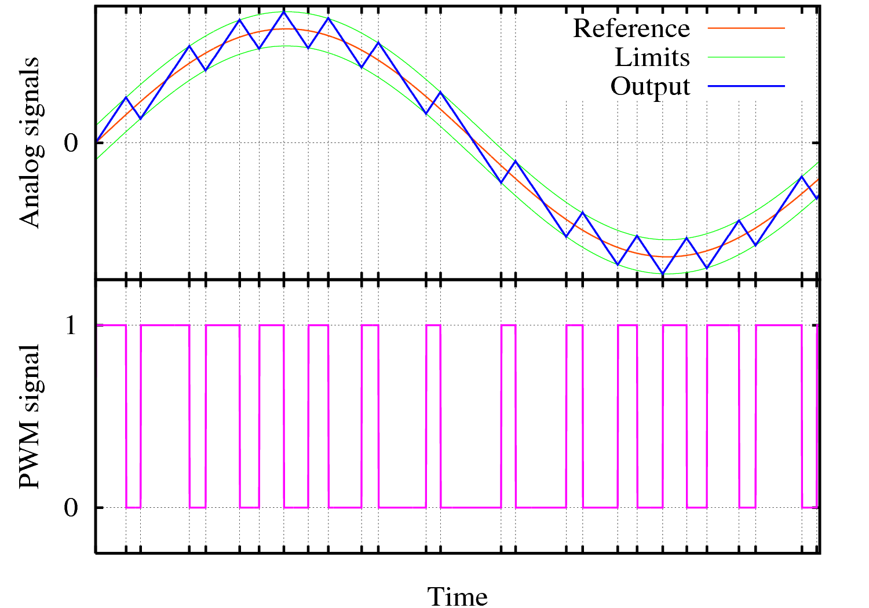
PWM concept
Pulse-width modulation (PWM)or pulse-duration modulation (PDM):-
Pulse Width Modulation, or PWM, is a technique for getting analog results with digital means. Digital control is used to create a square wave, a signal switched between on and off.
This on-off pattern can simulate voltages in between full on (5 Volts) and off (0 Volts) by changing the portion of the time the signal spends on versus the time that the signal spends off. The duration of "on time" is called the pulse width.
It is used to allow the control of the power supplied to electrical devices, especially to inertial loads such as motors.

Slide 18
Supporting code
If(distance<=10)
{
void motor_stop(){
digitalWrite(motor_left[0], LOW);
digitalWrite(motor_left[1], LOW);
digitalWrite(motor_right[0], LOW);
digitalWrite(motor_right[1], LOW);
delay(25);
}
}

Slide 19
WIFI Module
If due to some consequences the navigation is causing another accident and the braked got jammed or failed then the Wi-Fi module sends an alert message to the given numbers and to the emergency numbers

Slide 20
Supporting code
#include <ESP8266WiFi.h>
const char* ssid = “connect";
const char* password = “*****";
void setup() {
Serial.begin(115200); //sets the baud rate for data transfer in bits/second
pinMode(sensorPin, INPUT);//the ultrasonic sensor will be an input to the arduino
pinMode(buzzerPin, OUTPUT);//the buzzer serves an output in the circuit
// digitalWrite(ledPin, HIGH);
// Connect to WiFi network
Serial.print("Connecting to ");
Serial.println(ssid);
WiFi.begin(ssid, password);
while (WiFi.status() != WL_CONNECTED) {
delay(500);
}
Serial.println("WiFi connected");
// Start the server
server.begin();
Serial.println("Server started");
}

Slide 21
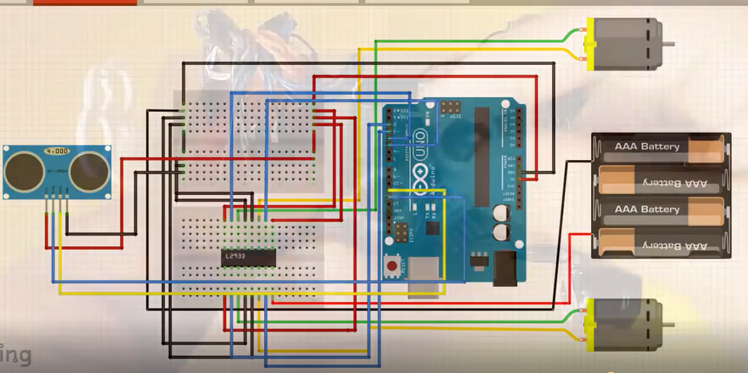

Slide 22
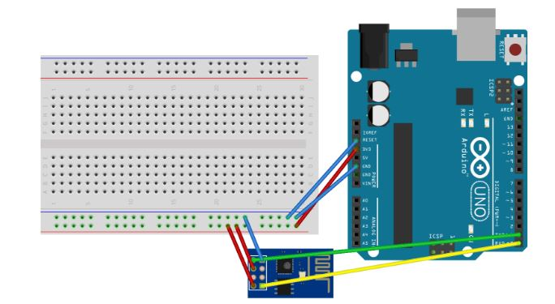

Slide 23
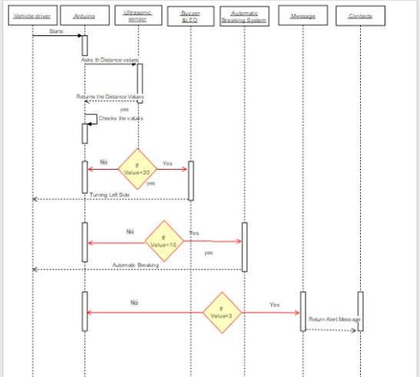

Slide 24
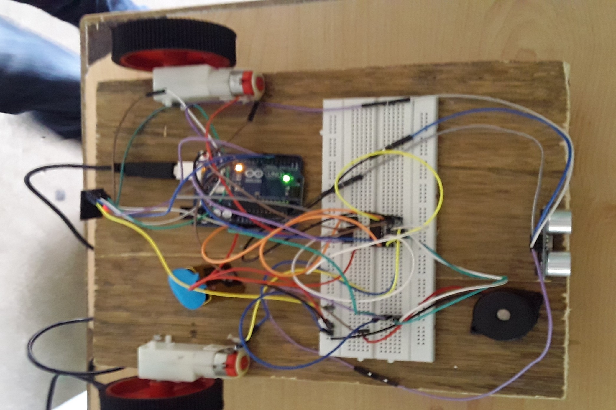

Slide 25
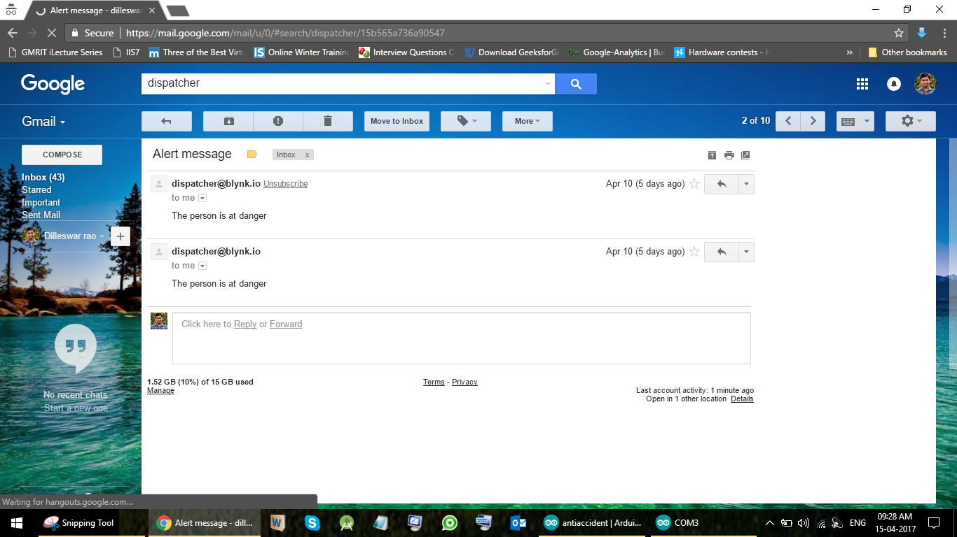

Slide 26
THANK YOU
17 March 2017

